Slide 1
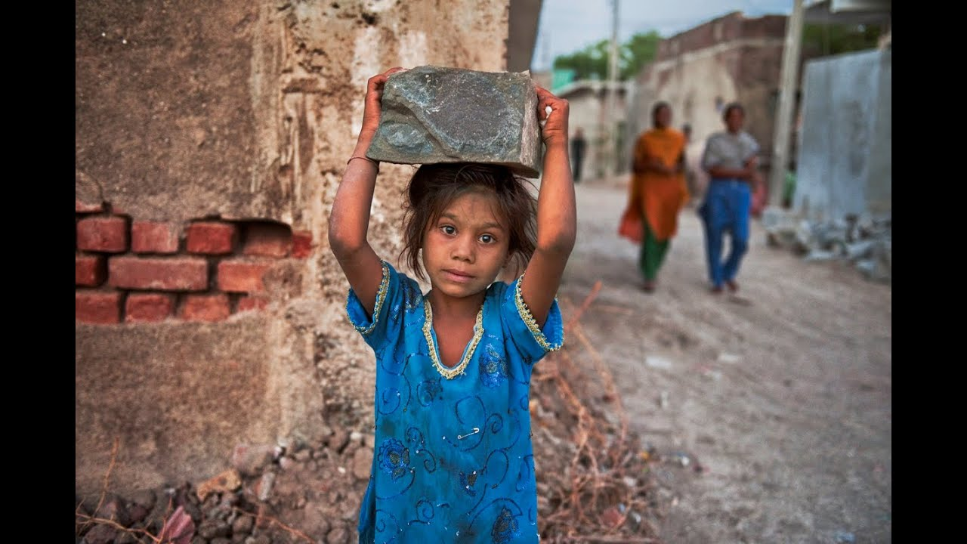

CHILD IS MEANT TO LEARN, NOT TO EARN
Dream
Reality
HOW ABOUT FINANCIAL HELP SYSTEM AT SCHOOLS ?
Notes:
This is an important problem around the world. I am sure you know about this problema. 1 in 10 children worldwide are 'out-of- school'.
The main cause is based on Poverty and children go to work instead of go to learn.
A Child, is Meant to Learn, Not to Earn.
We have an idea to help to you to get a child dream to reality.
<Next Slide Please>

Slide 2









FUJITSU
DIGITAL DISRUPTIVE TECHNOLOGIES
& SPONSORSHIP
NGOs FOCUSED ON OUR PROBLEM
MORE CHILDREN GOING TO SCHOOLS
SMART FINANCIAL HELP PLATFORM
Notes:
NGO, Governments, Individuals and Companies via CSR programs are supporting them but evidently it help is not enough.
Business Proposed is: That is why we decide create a SMART FINANTIAL HELP PLATFORM using disruptive technology & Sponsorship by Fujitsu. Which will support to NGO focused in a same problem we are trying to solve. INCREASE quantity of children going to school, improving school infrastructure, including water, sanitation, food and support the economic activities of parents of children in risk of child labour

Slide 3









SMART FINANCIAL HELP PLATFORM
TARGET ASSESSMENT
Data Analytics - AI
1
2
3
4
5
CONTINUE EVALUATION
SUBMISSION FOR HELP
Deep Learning
Smart contracts
Cloud Platform
Mobile Apps
Human
Centric
Innovation
RECEIVE A HELP
MAKE A DONATION
Digital Wallets
Smart Contracts
e-Logistics
Blockchain system
Smart Contracts

Slide 4


Slide 5
ASSESSMENT | Impact (Stakeholders) analysis
Sponsor (Fujitsu)
Contribution to society (CSR)
Publicity of Fujitsu technology
Employees’ Experience
Profit from new solution
Customers (NGOs)
Reliability and Traceability of donation
Optimization of work
Increase Funders Trust due to transparency
Community & Governments
Decrease the number of children who cannot go to school
Contribute to SDGs target 4
Cost reduction
Connect Supporters and Receivers

Slide 6

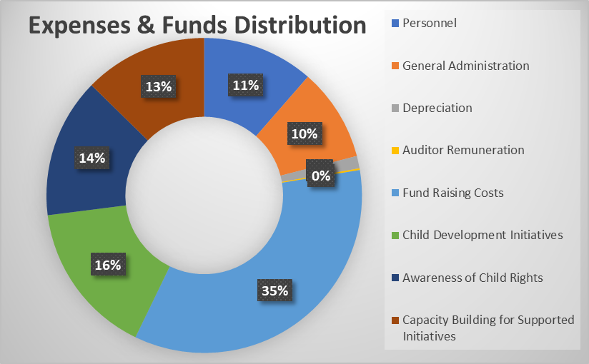
ASSESSMENT | Example Use Case
“ Child Rights and You “ NGO from India
Expense and Fund Distribution Head | Solution Impact
Personnel | Reduce
General Administration | Reduce
Depreciation | Optimize
Auditor Remuneration | Neutral
Fund Raising Costs | Reduce
Child Development Initiatives | Increase
Awareness of Child Rights | Increase
Capacity Building for Supported Initiatives | Optimize
* Reference – Child Rights and You, India Annual Report

Slide 7
ASSESSMENT | Pro-forma Financial
Investment 900 KUSD
6 USD/yr price per child
Starting with 5 NGOs deals 1st year (40K NGOs around the world)
10000 covers each NGOs
1.25 M (0,5%) children helped
in 3 years
84% IRR

Slide 8
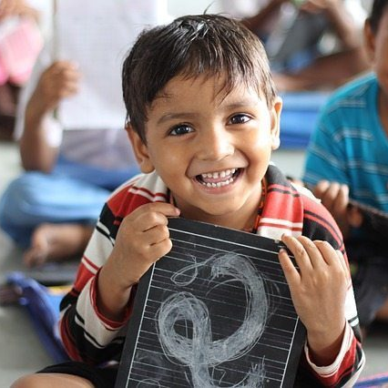

We decide GO!
..and you?
Let’s help children go to school together!
Notes:
We call for action to,
Fujitsu, to help sponsor the Technology Platform.
We also encourage all Fujitsu employees to join the Task Force with help of Responsible Business enrolments.
Come, Join Us !! Let us make their Dream Come True
<End of Presentation>

Slide 9
NEXT STEPS | Requirements for MVP
Define Fujitsu member as sponsor.
Funding for MVP about 100KUSD
Support from Fujitsu employees (Ex: System engineers, Solution architects, producto owners) with high skills in disruptive technologies (Blockchain, AI, Data Analytics, etc)
Support from Fujitsu CSR to establish NGOs partnership.
Support from Marketing áreas to desing a marketing plan.

